Slide 1


Financial Inclusion Dashboard
Analysis of Bank Account Ownership Across East Africa
Submitted By:
Suraj Nayak
Tools Used:
Power BI, Canva
Dataset:
Financial Inclusion in Africa Dataset

Slide 2
Project Overview
Objective
The objective of this project is to analyze financial inclusion and understand the factors influencing bank account ownership across East African countries.
The dashboard provides valuable insights into demographic, educational, and geographical patterns associated with financial access.
Dataset Information
Dataset Name: Financial Inclusion in Africa
Total Respondents: 23,524
Countries Covered:
Kenya
Rwanda
Tanzania
Uganda
Tool Used: Power BI
Key Performance Indicators (KPIs)
Total Respondents
Bank Account Holders
Financial Inclusion Rate
Average Age of Respondents

Slide 3
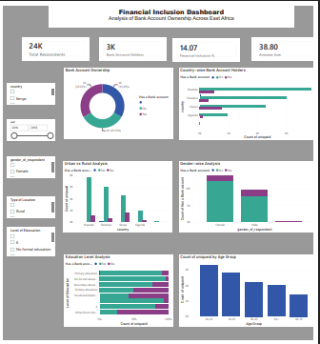
Dashboard Overview
Interactive Dashboard Features
The dashboard was designed to provide stakeholders with an interactive and visual understanding of financial inclusion trends.
Dashboard Components
KPI Cards for summary statistics
Bank Account Ownership Analysis
Country-wise Financial Inclusion Analysis
Urban vs Rural Comparison
Gender-wise Analysis
Education Level Analysis
Age Group Distribution
Interactive Slicers for filtering data
Filters Used
Country
Year
Gender
Location Type
Education Level

Slide 4




Key Findings
Major Insights from the Dashboard
Financial Inclusion Status
Total Respondents: 23,524
Bank Account Holders: Approximately 3,309
Financial Inclusion Rate: 14.07%
Average Age: 38.80 Years
Country Analysis
Kenya shows the highest level of bank account ownership.
Rwanda, Tanzania, and Uganda show comparatively lower levels of financial inclusion.
Significant differences exist among countries in access to banking services.
Demographic Analysis
Urban residents are more likely to own bank accounts than rural residents.
Financial inclusion varies across different age groups.
Educational attainment has a strong relationship with bank account ownership.

Slide 5
Business Insights and Recommendations
Business Insights
Financial inclusion remains relatively low across the surveyed population.
Rural populations face greater barriers to accessing banking services.
Higher educational levels are associated with higher rates of bank account ownership.
Young adults and low-income populations represent potential growth segments for financial institutions.
Recommendations
Expand banking infrastructure in rural regions.
Promote financial literacy and awareness programs.
Develop digital banking solutions for underserved populations.
Create targeted financial products for youth and low-income groups.
Strengthen partnerships between governments and financial institutions to improve financial accessibility.

Slide 6
Conclusion
This dashboard successfully demonstrates how data visualization can be used to understand financial inclusion patterns and support informed decision-making.
The analysis reveals that bank account ownership is influenced by factors such as country, education level, location, and age. The insights generated from the dashboard can help policymakers, banks, and financial organizations develop strategies to improve financial inclusion and expand access to formal banking services.
Thank You

